Slide 1





Atlas HR eServices My Leave New Leave Types 2016
Jury Duty Leave
Official Business
Rest & Recuperation
Compensatory Day Off
Floating Holiday

Slide 2
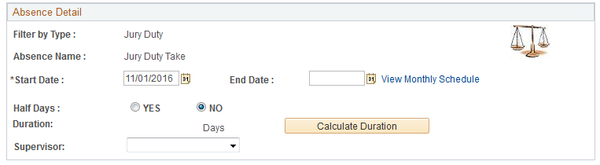
Jury Duty Leave - how to apply for Jury Duty leave

Slide 3
Floating Holiday (NY) - how to apply for a Floating Holiday
Approval in eServices:
Staff Member submits Floating Holiday Business request->
Supervisor approves the absence ->
Leave Monitor, staff member and supervisor is copied when approved by supervisor.
Requirements:
The fixed holidays in NY has been reduced from 10 to 9 to allow for a Floating Holiday. It is applicable for Staff members in New York who may observe one of the following 7 holidays as a Floating Holiday:
7 January Orthodox Christmas
15 February Presidents' Day
29 April Orthodox Good Friday
12 October Yom Kippur
20 May Day of Vesak
31 October Diwali
14 November Gurpurab
It is not possible to apply for ½ day.
It is not be possible to apply for 2 Floating Holidays within same year.
Relevant policy: ST/IC/2015/26

Slide 4
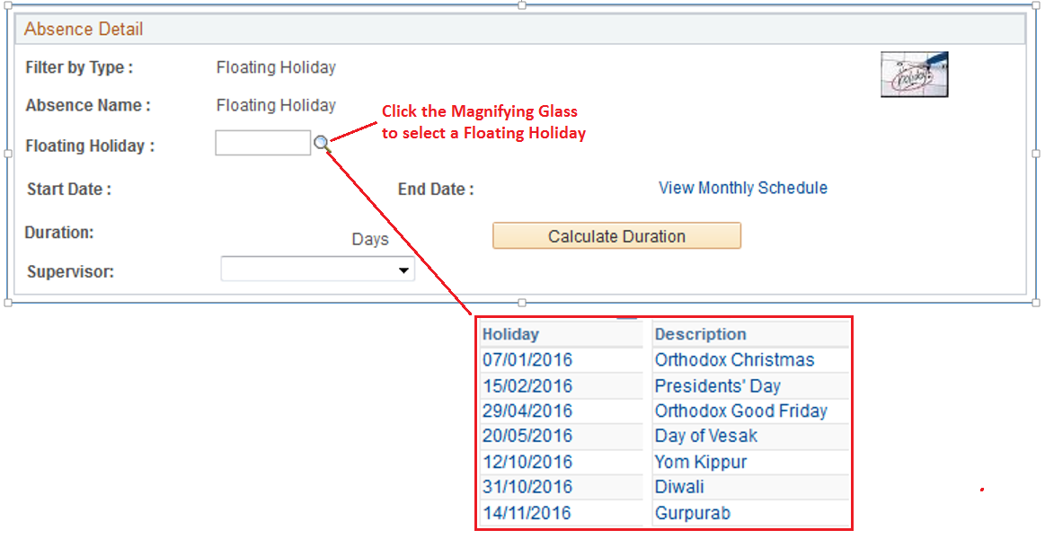
Floating Holiday (NY) - how to apply for a Floating Holiday

Slide 5
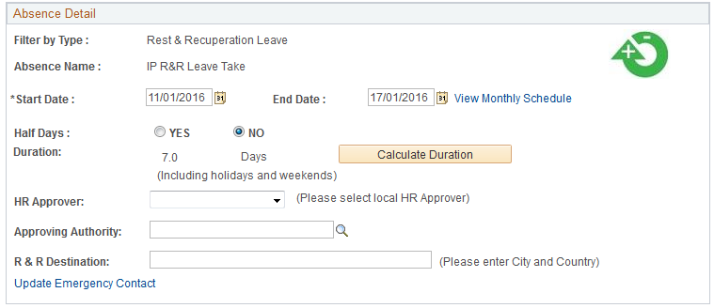
Rest & Recuperation (R&R) - how to apply for R&R
‘Approving Authority’ is Head of Office
Link to Emergency Contact in eServices

Slide 6
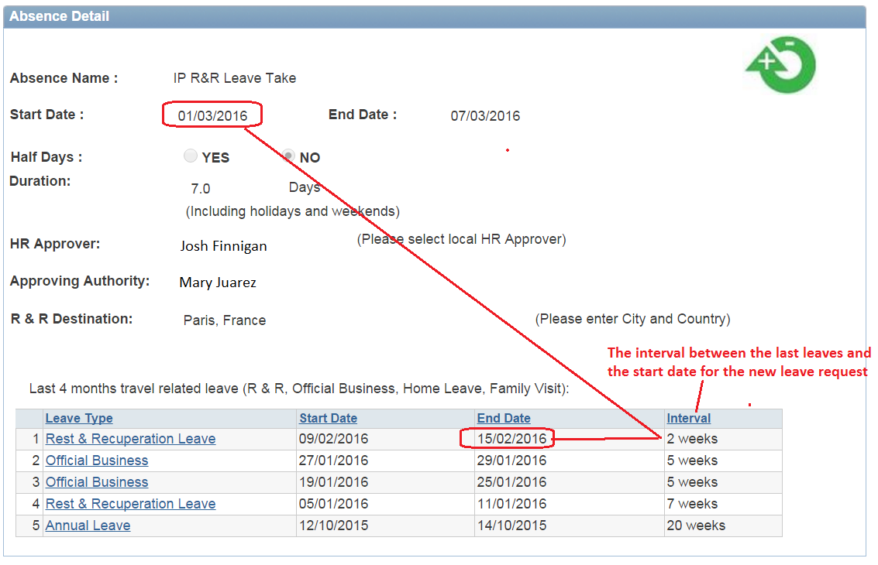
Rest & Recuperation (R&R) - how to approve R&R
The approvers can view the last 4 months travel related leave

Slide 7
Official Business - how to apply for Official Business travel
Approving Authority:
Travel by HQ staff: Head of the organizational unit sponsoring or funding the travel
Head of Bureau: Administrator or Associate Administrator
Administrator: Associate Administrator
CO staff: RR/RC
RR/RC: Head of Regional Bureau
Approval in eServices:
Staff Member submits Official Business request->
Supervisor approves the absence ->
Approving Authority approves the absence
Leave Monitor, staff member and supervisor is copied when approved by Approving Authority.
Requirements:
Applicable for International Professional and General Service Staff but will be available in the future for Service Contract Holders & UN Volunteers.
The staff member will enter official travel itinerary; this will include time of day for payment purposes.
The future aim for Official Business is to link the travel and budget information to Atlas Finance for efficient processing of payments.
Relevant policy:
Authorizing Official Business Travel in POPP

Slide 8
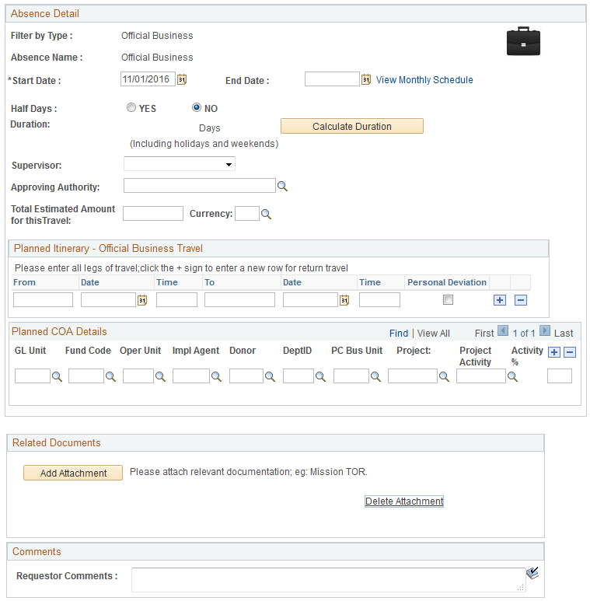
Official Business - how to apply for Official Business travel
If you have a personal deviation, then click the tick-box for ‘Personal Deviation’.
Enter COA
Attach Mission TOR or other relevant information

Slide 9
Compensatory Day Off (CDO) - how to apply for CDO for travel compensation
Policy:
A staff member will be granted a compensatory day off if required to travel on a non-working day to or from the duty station to a place of mission. This compensatory day off may be exercised immediately after the non-working day or within four (4) months of return to the duty station, upon approval.
Approval in eServices:
Staff Member submits Compensatory Day Off ->
Supervisor approves the absence ->
Leave Monitor approves the eligibility for CDO ->
Once approved by Leave Monitor an email is forwarded to the staff member, supervisor and Leave Monitor.
Requirements:
Applicable for International Professional and General Service Staff but will be available in the future for Service Contract Holders & UN Volunteers.
The CDO request page will display the last 4 months Official Business periods. It is possible to link in to the Official Business periods for more detailed information.
Note:
Compensatory Day Off (CDO) should not be mistaken with Compensatory Time Off (CTO) which is used for overtime compensation for local staff. CTO should still be entered manually if overtime compensation is taken as time off.

Slide 10
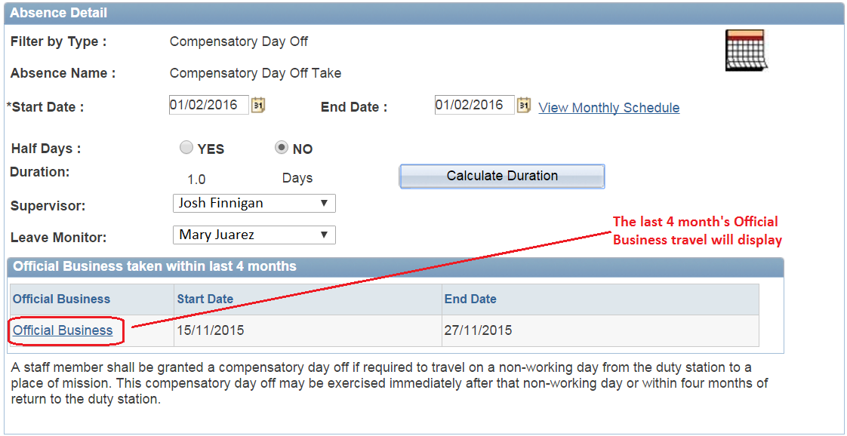
Compensatory Day Off (CDO) - how to apply for CDO for travel compensation

Slide 11
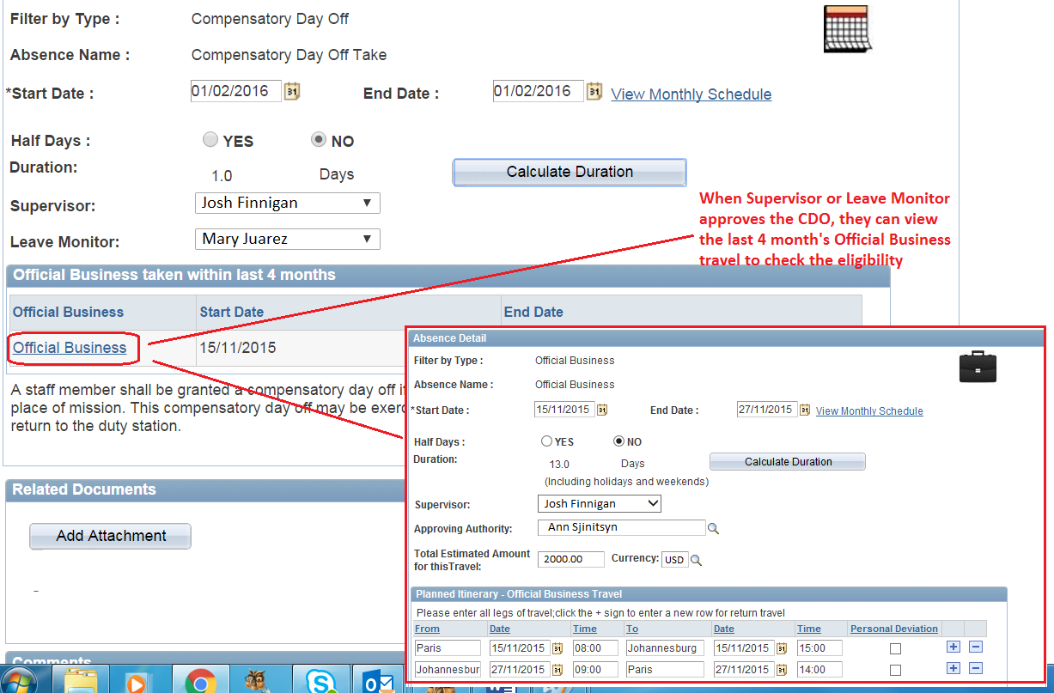
Compensatory Day Off (CDO) - how to approve CDO

Slide 12
Q&A
Rest & Recuperation
Floating Holiday
Jury Duty Leave
Official Business
Compensatory Day Off

